Slide 1
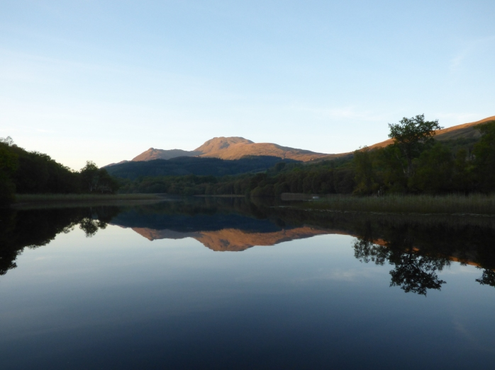
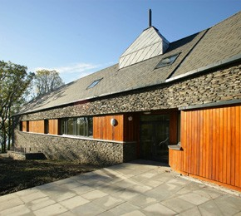
Welcome!

Slide 2

TRAINING WORKSHOP
SCENE, University of Glasgow
26-30th June 2023

Slide 3



Who are we?
Kirstyn Brunker
Criselda Bautista
Gurdeep Jaswant
Kathryn Campbell
Laura Bergner
Rowan Durrant
Smitha Abraham
Martha Luka
Notes:
Creeping death

Slide 4
Workshop etiquette
Keep off your phones!
Demonstrator hands up- attention please
General lab rules apply
Respect each other

Slide 5
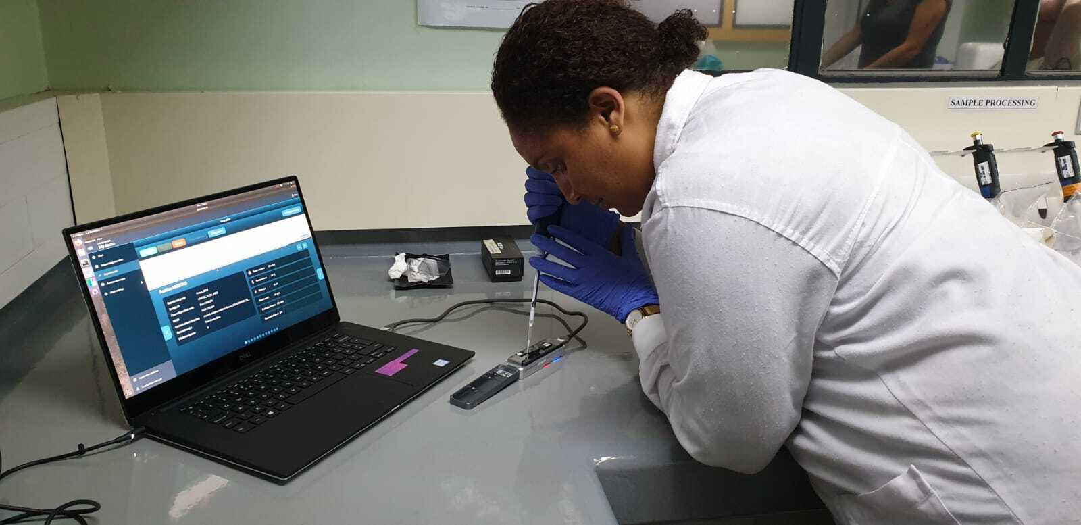
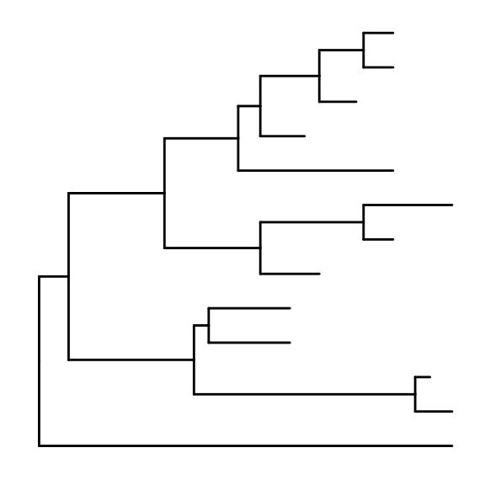
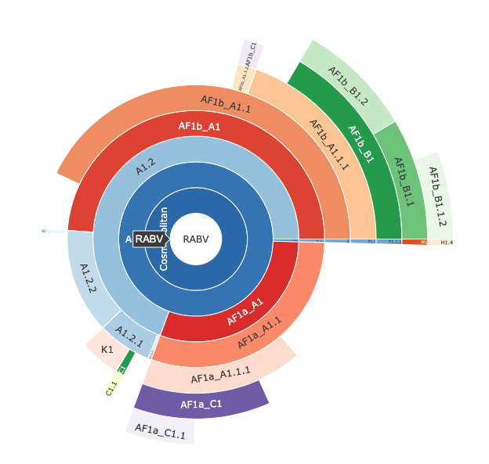
Workshop content
An introduction to genomic surveillance for rabies virus
Wet lab
Sequencing library preparation
Nanopore sequencing
Real-time monitoring
Dry lab
Processing raw data
Building trees
Visualising & interpreting your data

Slide 6
Bautista et al., JoVE, accepted

Slide 7
Schedule
 | MONDAY | TUESDAY | WEDNESDAY | THURSDAY | FRIDAY
AM | Welcome & Icebreaker! | Normalisation practical | Overview of data | Alignments | MADDOG
 | Intro seminars: Genomic surveillance Nanopore seq | Nanopore library prep | Intro to command line Bioinformatics pipeline | Tree building & visualisation | MADDOG interpretation
PM | Lab pipeline overview Considering sample prep | Nanopore library prep | Bioinformatics pipeline | Tree annotation | Microreact
 | Lab masterclass sessions | Sequencing Seminar: RABV seq in practice | Sequence QC | GenBank submission

Slide 8
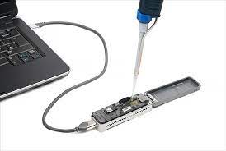

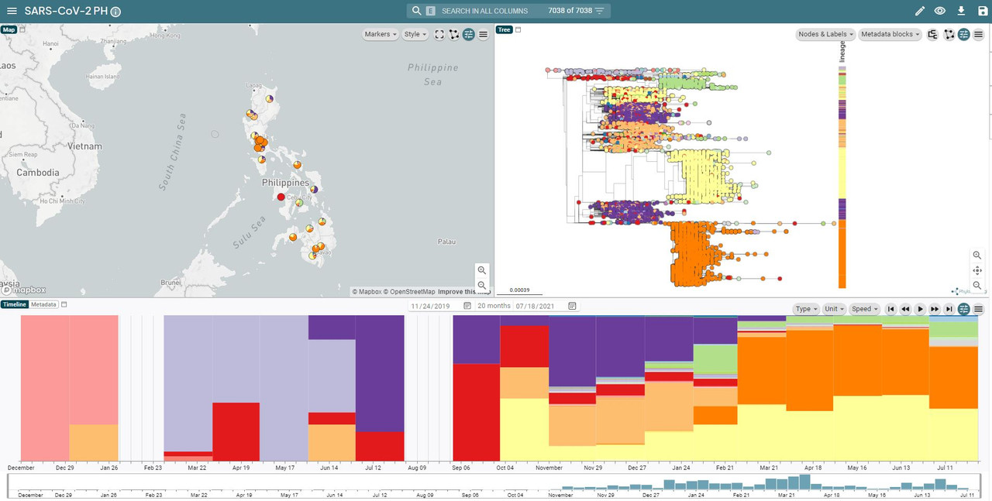
Schedule
MONDAY | TUESDAY | WEDNESDAY | THURSDAY | FRIDAY
INTRO AND WET LAB | WET LAB | DRY LAB | DRY LAB | DRY LAB
Background and lab masterclass sessions | Nanopore library prep & sequencing | Intro to bioinformatics | Alignments and phylogenetic trees | Advanced interpretation & visualisation

Slide 9
What are your expectations?
POLL
https://PollEv.com/surveys/fWiyeJySJ3mVr7VFiloHV/respond

Slide 10
Who are you?

Slide 11

Speed dating!
Split into 2 groups
3 minute rounds
Each person takes it in turn to answer set of questions (next slide)
Each answer q1 before moving on to next q… etc
At the end of each round (DING!):
Group 1 stays seated
Group 2 rotates

Slide 12
Questions
Introduce yourself
What are you hoping to gain from the workshop?
If you could be an animal- what would you be and why?
Q1
Q2
Q3
NEXT

